Slide 1

Book
Recommendation
System
Project No:274
Group 3:
Presented by:
SHUBHAM SOLSI
SIMRAN NAIK
Associated with: ExcelR
Date: 31/08/2023

Slide 2

PROBLEM STATEMENT
Our business goal is to offer personalized book recommendations by leveraging the Book Crossing dataset, comprising Books, Users, and Ratings.
Books Dataset
Contains book details like titles, authors, publication year, publisher, and images. These attributes help us understand book’s content and theme.
Users Dataset
Includes user IDs, demographic info, and age. This aids in understanding reading preferences and interests.
Rating Dataset
Contains user ratings and reviews for books. This data reveals user preferences and book popularity, crucial for recommendations.

Slide 3
Project Flow-
Defining Project objective
Data collection
EDA-Exploring and Visualize the data.
Recommendation system
Deployment

Slide 4

DATA DESCRIPTION
There are three datasets
Books
Users
Ratings
Based on this data we have to build a book recommendation system for users.

Slide 5

Books Dataset
No of books : 271360
Columns : ISBN, Book-Title, Author name ,Year of publication, Image URL
Users Dataset
No of Users/Readers : 278858
Columns : User-ID, Location, Age
Ratings Dataset
No of Ratings : 1149780
Columns : User-ID, ISBN, Book_Ratings

Slide 6

EDA(EXPLORATORY DATA ANALYSIS)

Slide 7

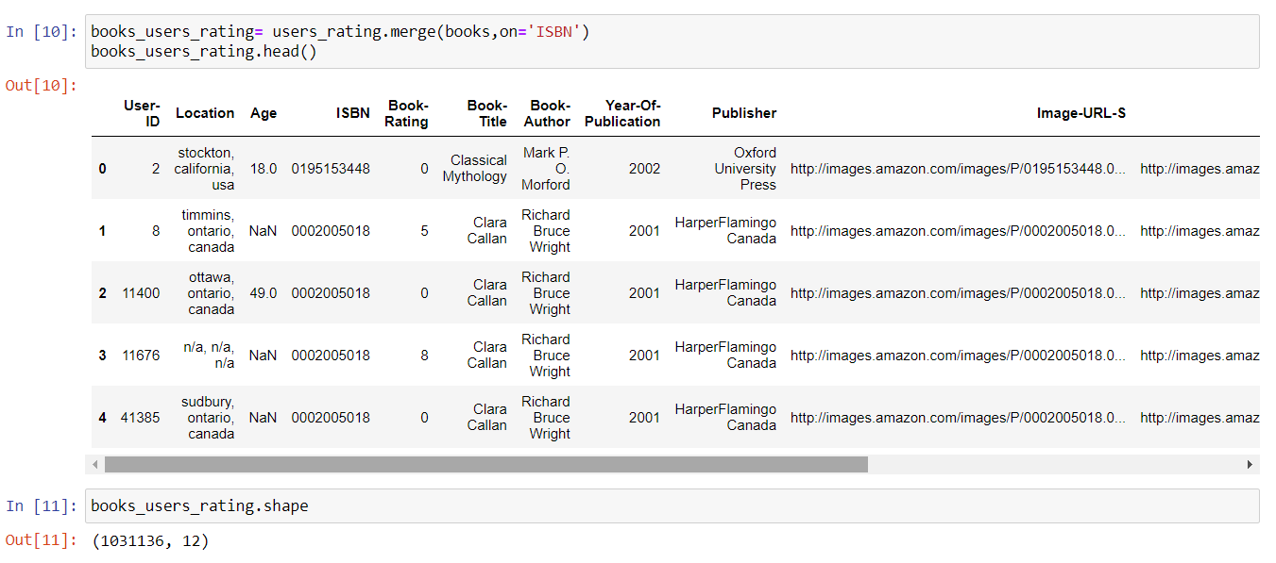
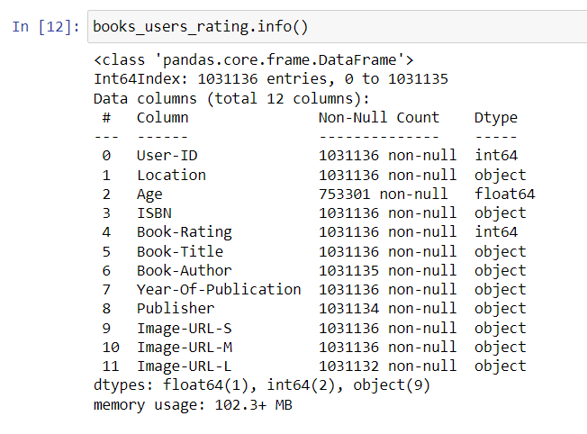
MERGING ALL THREE DATASETS
We have consolidated our data from three datasets—Users, Books, and Ratings—into a single dataset named "Books_Users_Ratings," which comprises 1,031,136 rows and 12 columns.
This integrated dataset forms the foundation for our personalized book recommendation system.

Slide 8

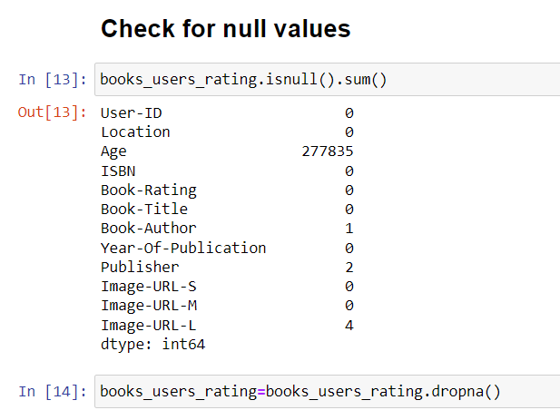
CHECKING FOR NULL VALUES AND TREATMENT
We've removed 2,77,835 rows with null values in the "Age" column, as age significantly influences book recommendations.
Now, our dataset contains 753,296 rows and 12 columns, ensuring a more robust foundation for our recommendation system.

Slide 9
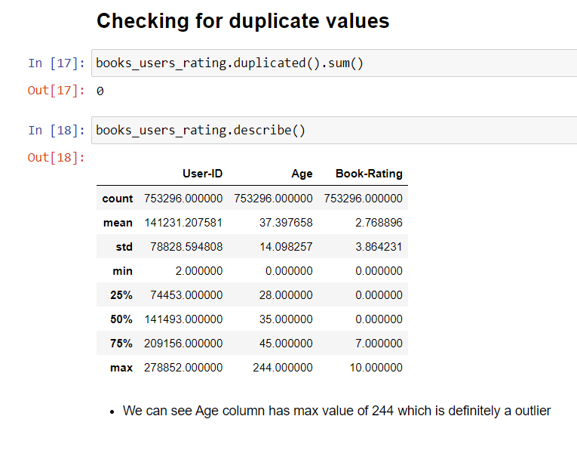
CHECKING FOR DUPLICATE VALUES AND DESCRIPTION OF AGE AND RATING COLUMNS
Our dataset is free of duplicate values. However, we've noticed an outlier in the "Age" column with a maximum value of 244, which is highly unlikely and should be considered an error.
We'll address this issue to ensure data accuracy and reliability for our book recommendation system.

Slide 10
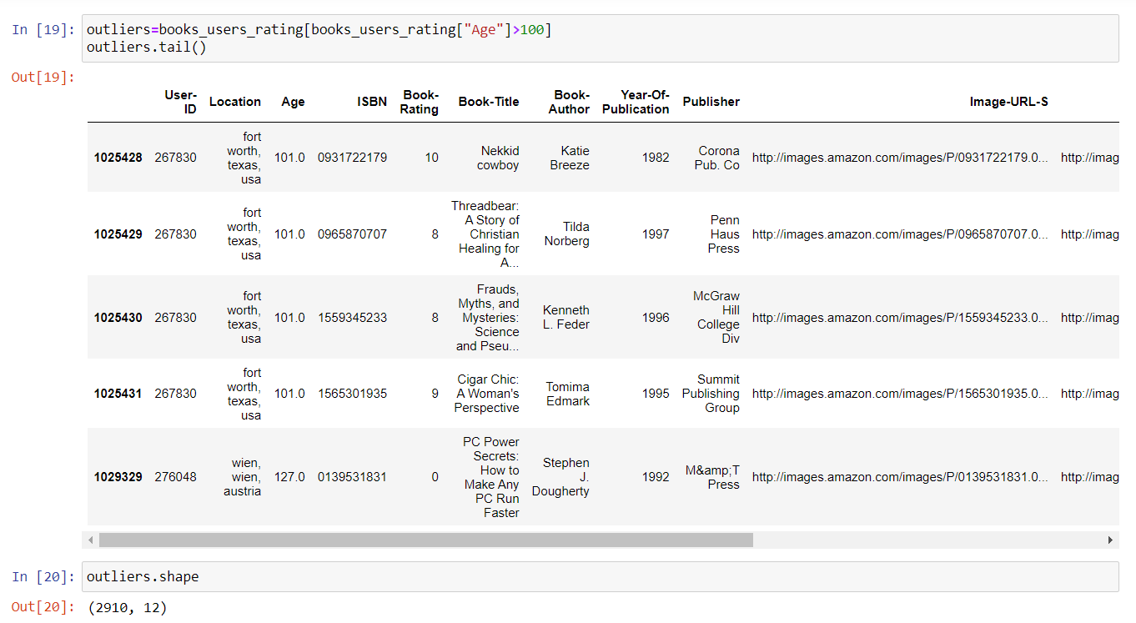
OUTLIER DETECTION AND TREATMENT
We've established a threshold age of 100, and any age value exceeding this threshold is considered an outlier.
There are a total of 2,910 rows with ages greater than 100.
To enhance data quality, we have removed these outlier rows from our dataset.

Slide 11

DATA PRE-PROCESSING

Slide 12
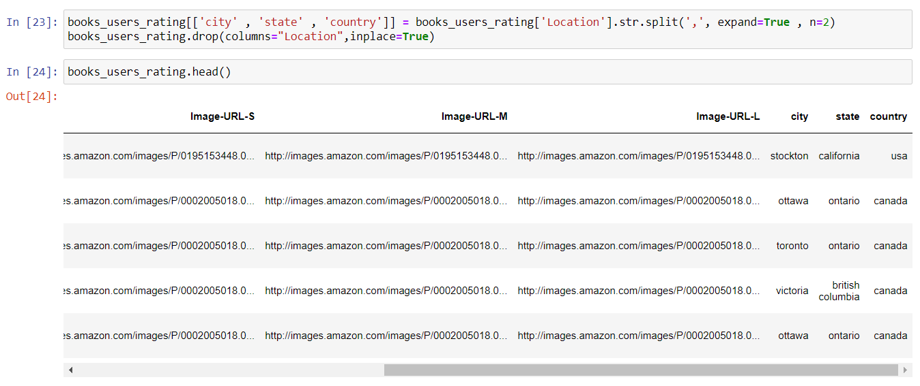
CREATING NEW COLUMNS FROM THE LOCATION DATA
We've improved the dataset by splitting the values in the "Location" column using the `.split()` method to create three new columns: "City," "State," and "Country.“
This separation enables us to better analyze and utilize geographical information in our book recommendation system.

Slide 13

VISUALIZATION

Slide 14
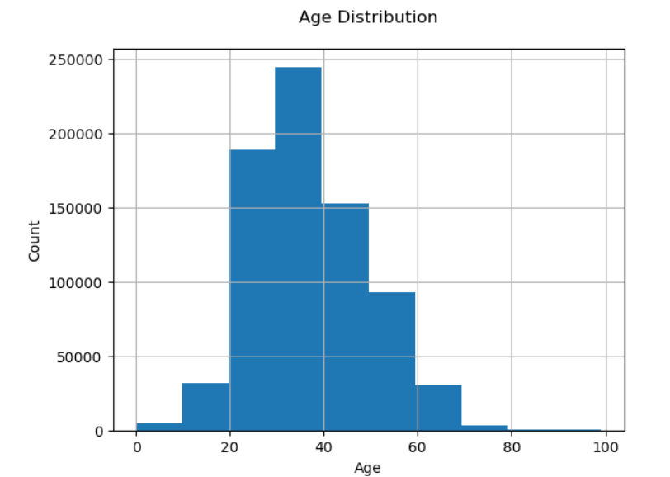
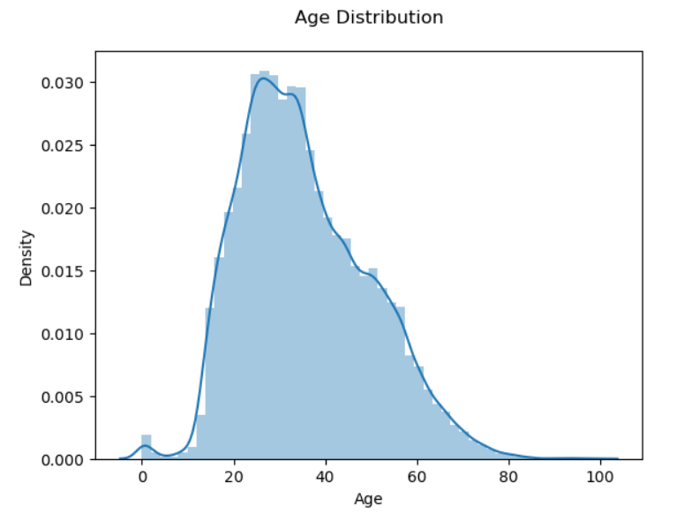
AGE DISTRIBUTION OF USERS
Our dataset predominantly consists of readers aged between 25 and 40, representing the majority of users.
Conversely, readers aged 80 to 100 years form a very small minority within our user base.

Slide 15
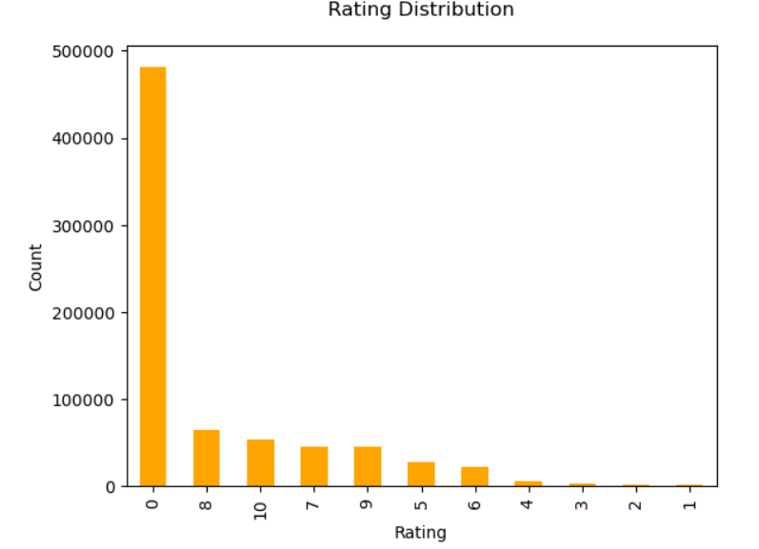
RATING DISTRIBUTION
Approximately 4,80,000 books in our dataset have received zero ratings.
80k-70k Books have approximately have received 8 ratings.

Slide 16
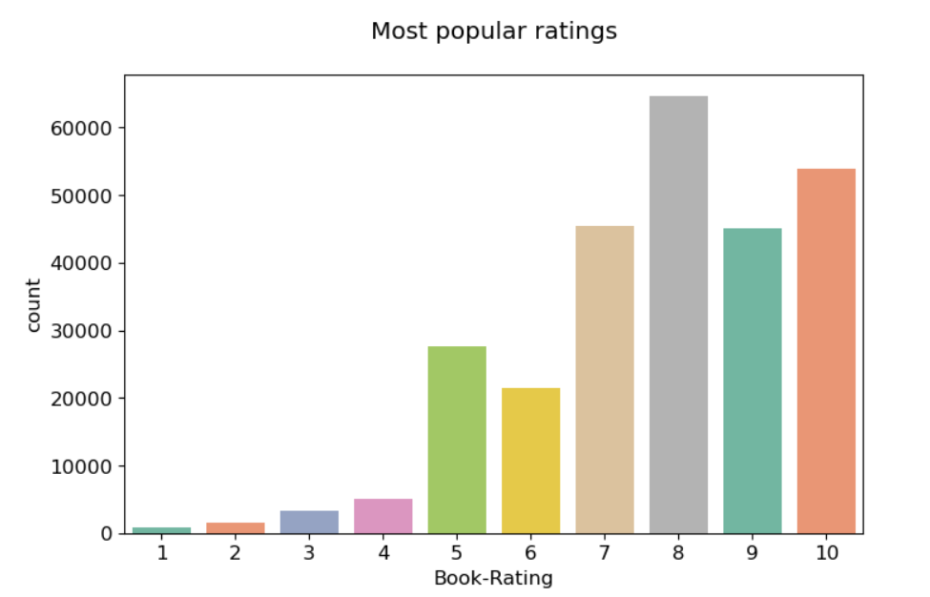
NON ZERO/MOST POPULAR RATING
The majority of users have rated books with scores above 4.
The most frequently assigned rating is 8.

Slide 17
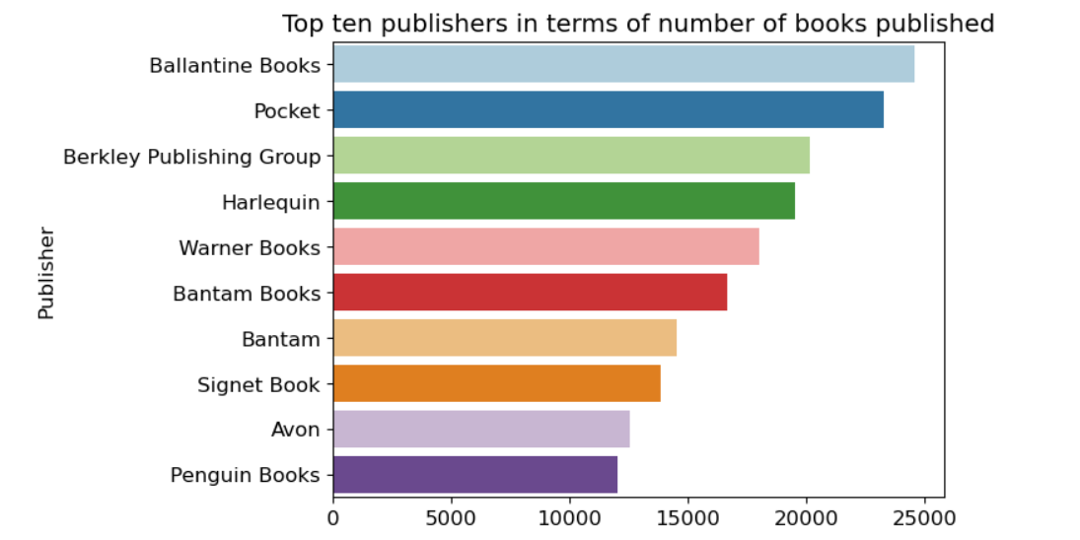
PUBLISHER WITH MOST BOOKS
Ballantine Books is the most popular publisher based on the number of users who have rated their books.

Slide 18
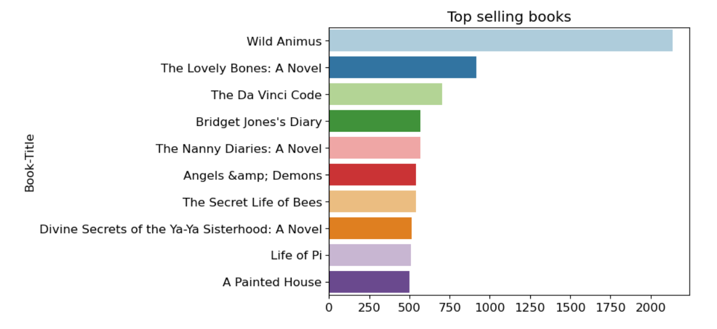
TOP SELLING BOOKS
Wild Animus is the highest-selling book followed by The Lovely Bones: A Novel.

Slide 19
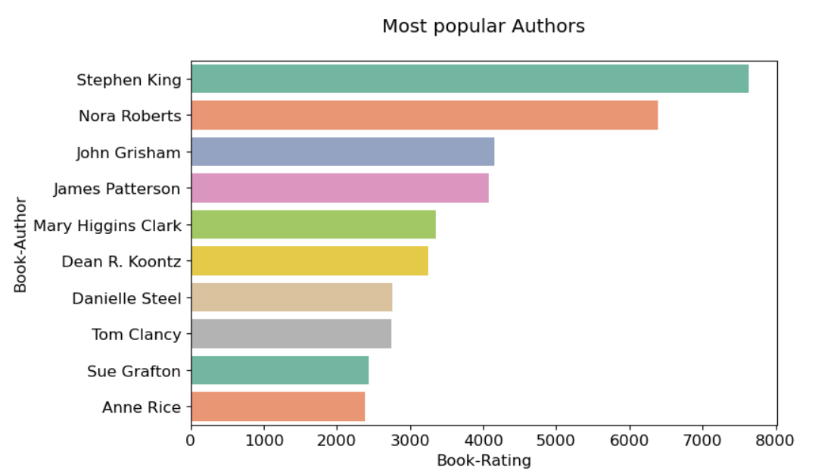
MOST POPULAR AUTHOR
Most popular book author with respect to the number of ratings is Stephen King.

Slide 20
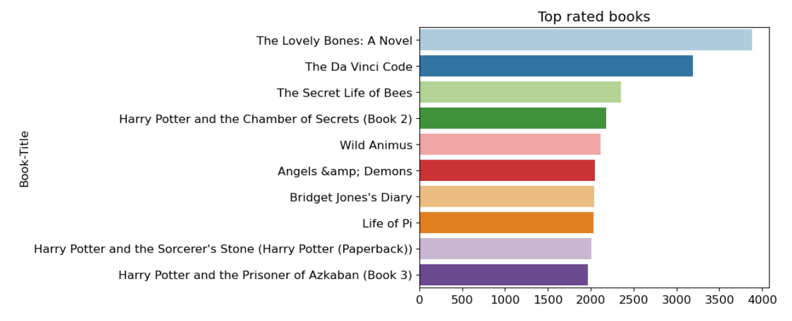
TOP RATED BOOK
Lovely Bones: A Novel is the highest-rated book , followed by The Da Vinci Code.

Slide 21
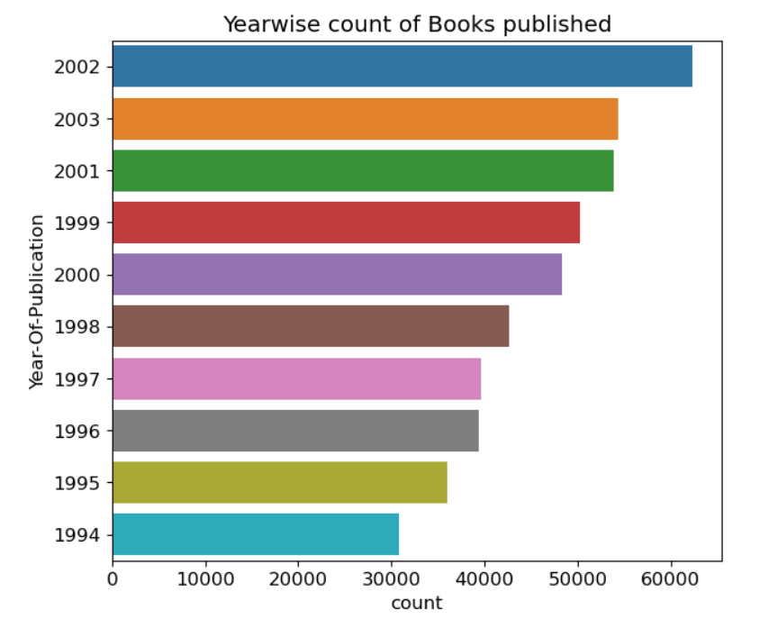
YEAR WISE COUNT OF BOOK PUBLISHED
In the year 2002, the highest number of books were published.
In the year 1994, the lowest number
of books were published.

Slide 22
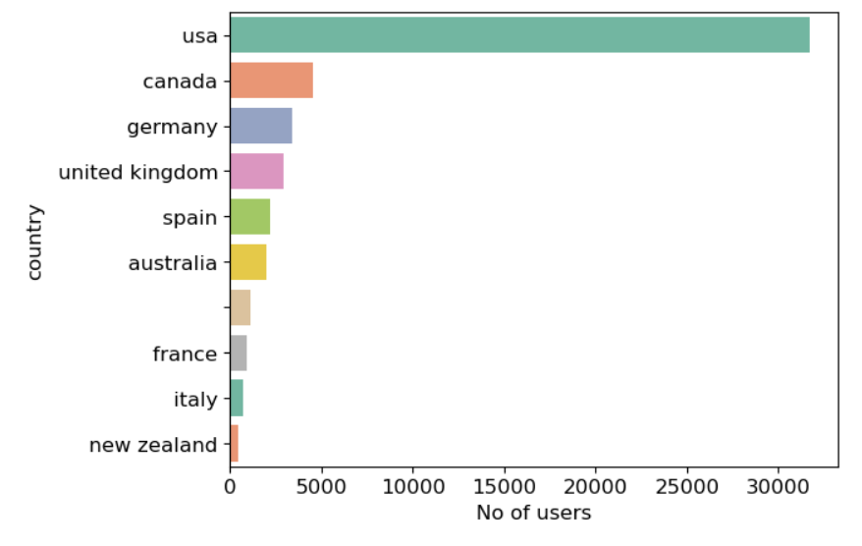
COUNTRIES WITH MOST READERS
Most of the readers are from the United States followed by Canada.
Lowest number of readers are
from New Zealand.

Slide 23
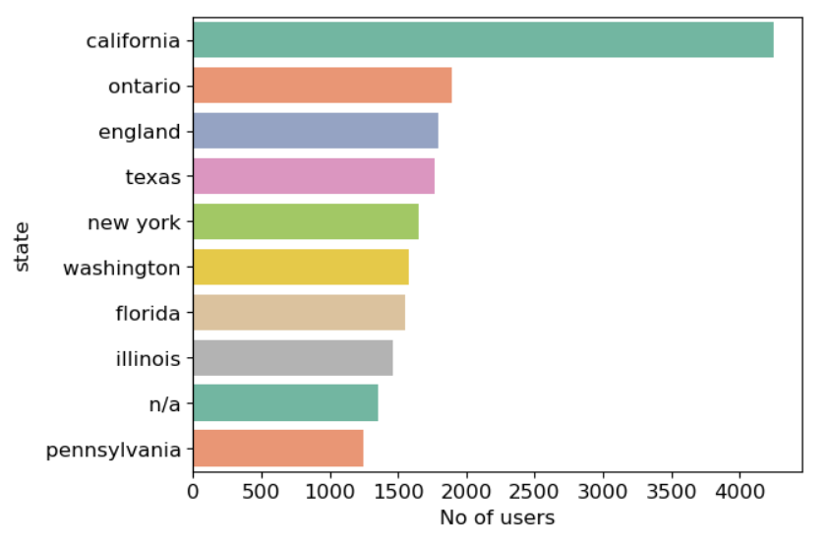
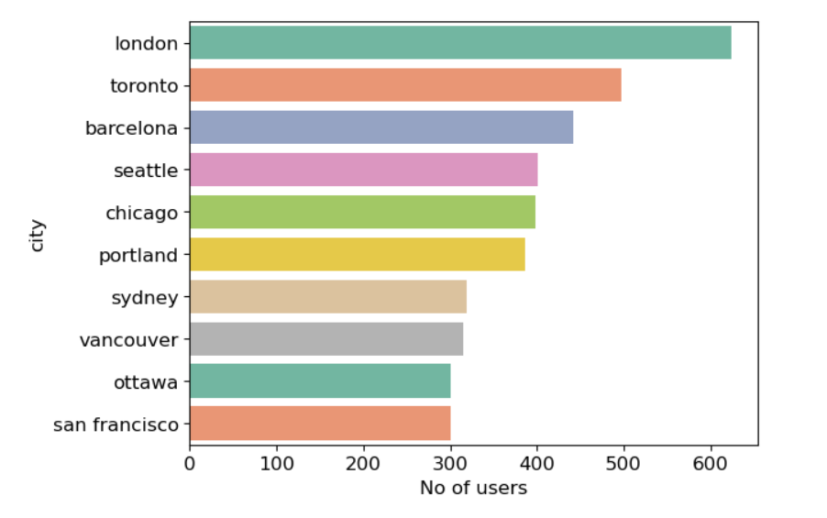
STATE AND CITY WISE MOST READERS
In the state California has the most readers and in the city, London has the most readers.
In the state Pennsylvania has the lowest number of readers and in the city, San Francisco has the lowest number of users

Slide 24
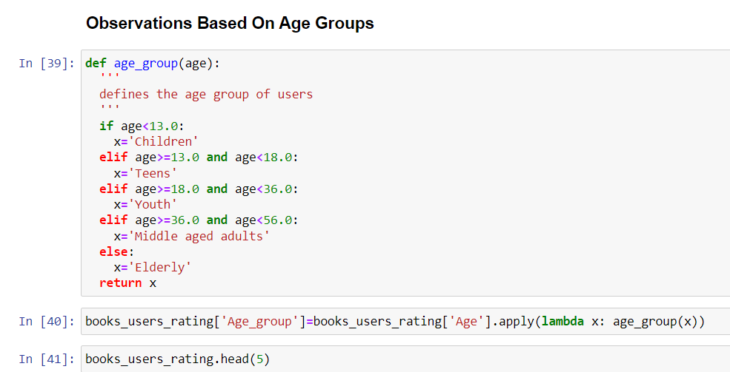
CREATING NEW COLUMN AGE_GROUP

Slide 25
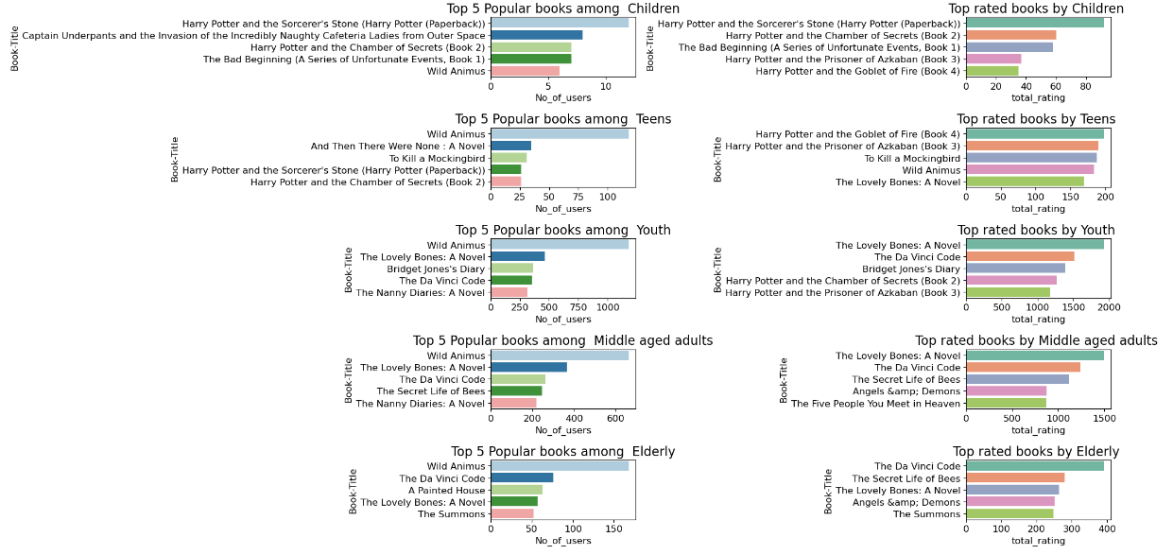
AGE WISE PLOTTING

Slide 26

EDA CONCLUSIONS
"Wild Animus" is the most widely read book across all age groups.
Stephen King is the most popular author, based on the number of ratings received.
Ballantine Books and Pocket are the top publishers, with the highest number of ratings for their books.
The majority of readers fall within the age range of 25 to 40.
Most readers who have provided ratings are from the United States and Canada.
"The Lovely Bones" holds the highest rating among Youth & Middle-aged Adults.

Slide 27
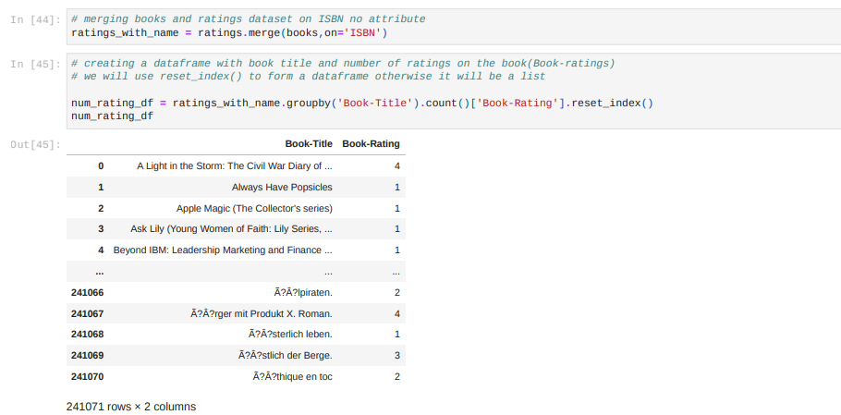
Building the Recommendation System
POPULARITY BASED RECOMMENDER SYSTEM:
Top 50 books with highest average ratings

Slide 28
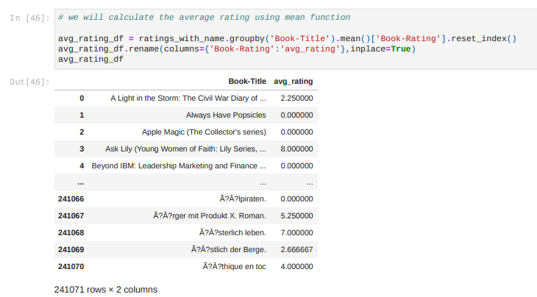
CALCULATING THE AVERAGE RATING USING MEAN FUNCTION

Slide 29
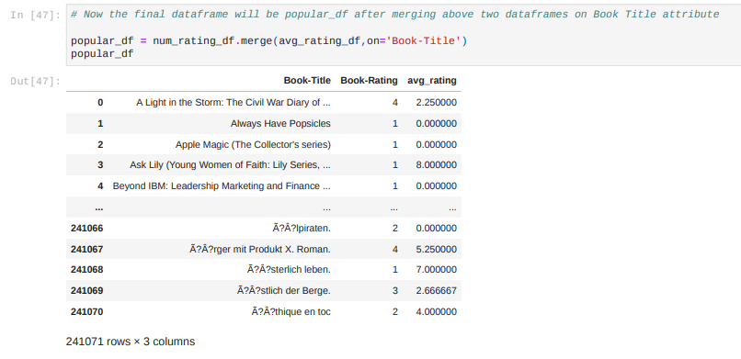
MERGING THE TWO DATA FRAMES ON BOOK TITLE ATTRIBUTE TO GET THE FINAL DATA FRAME

Slide 30
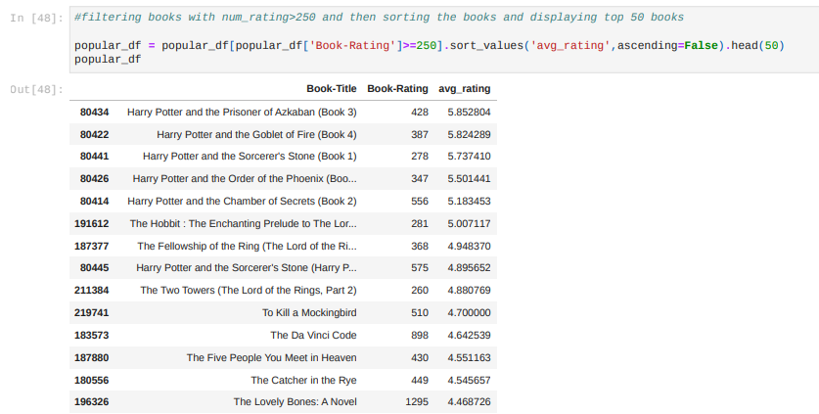
Considering those books whose book rating is more than 250.

Slide 31
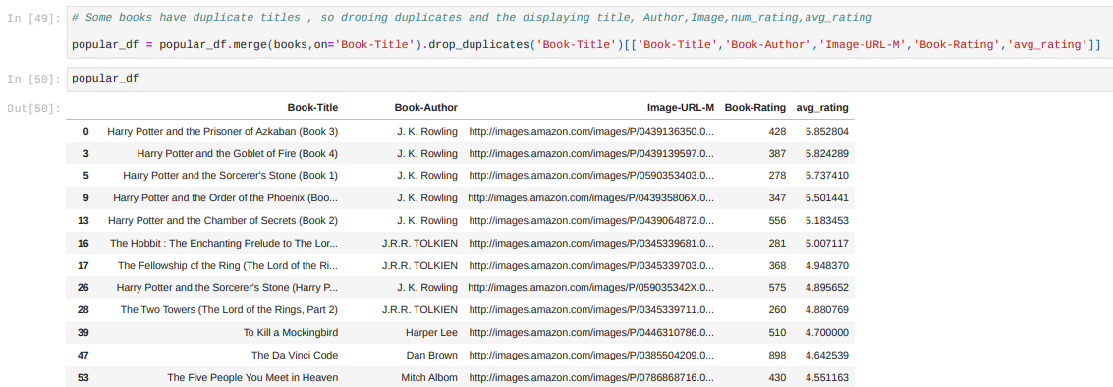
Dropping the Duplicate Titles

Slide 32

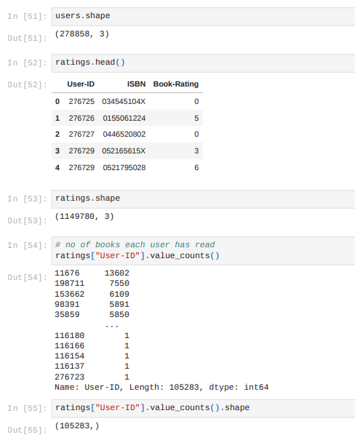
2) COLLABORATIVE FILTERING BASED RECOMMENDER SYSTEM
Approach: To enhance the accuracy of our recommendation model, we will implement the following criteria:
Select Users:
We will focus on users who have rated more than 200 books. This ensures that we consider active and engaged users who can provide meaningful insights into their preferences.
Select Books:
We will choose books that have been rated by more than 50 users. This helps filter out books with limited ratings and ensures that recommendations are based on a wider consensus of user opinions.
By implementing these criteria, we aim to improve the precision and relevance of our book recommendation model.

Slide 33
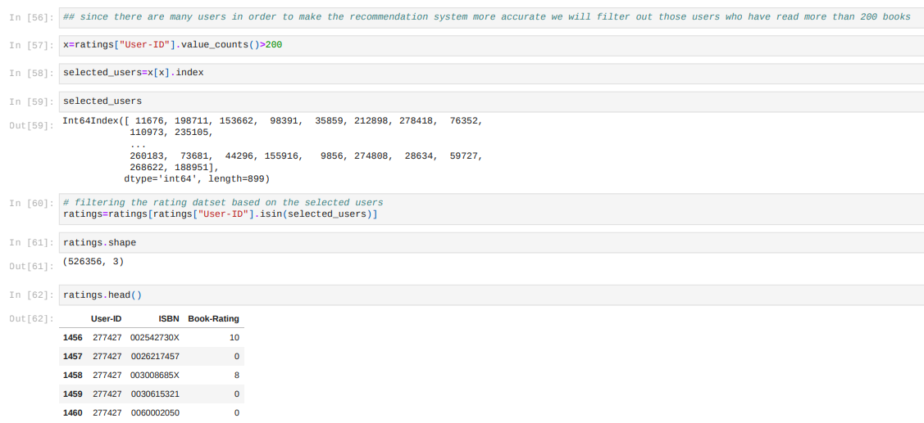
FILTERING THE RATING DATASET BASED ON THE SELECTED USERS

Slide 34

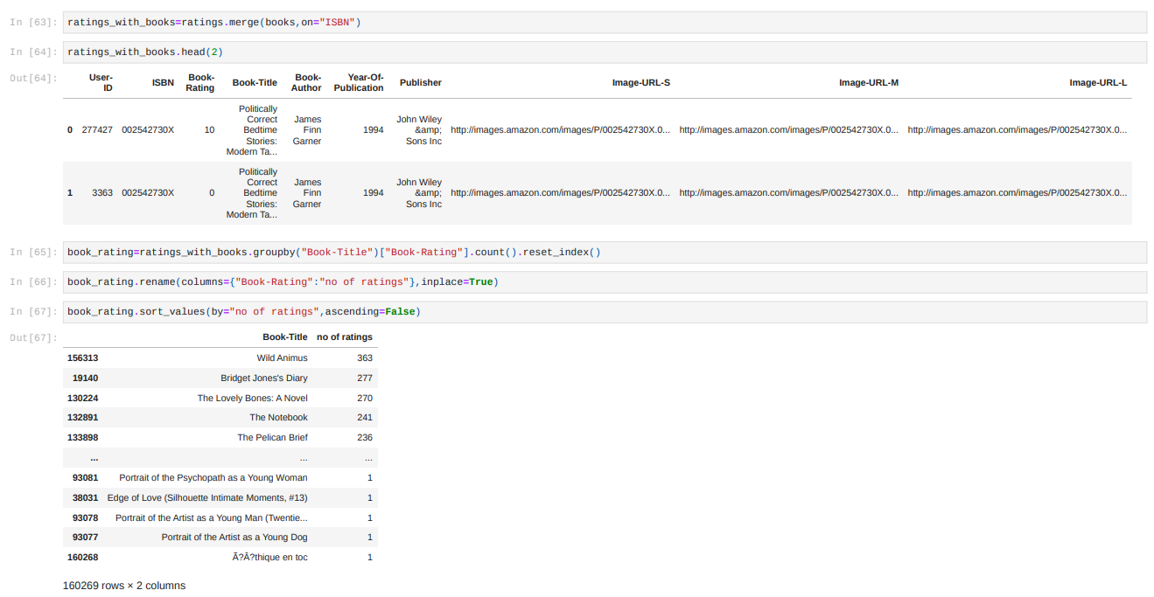

Slide 35
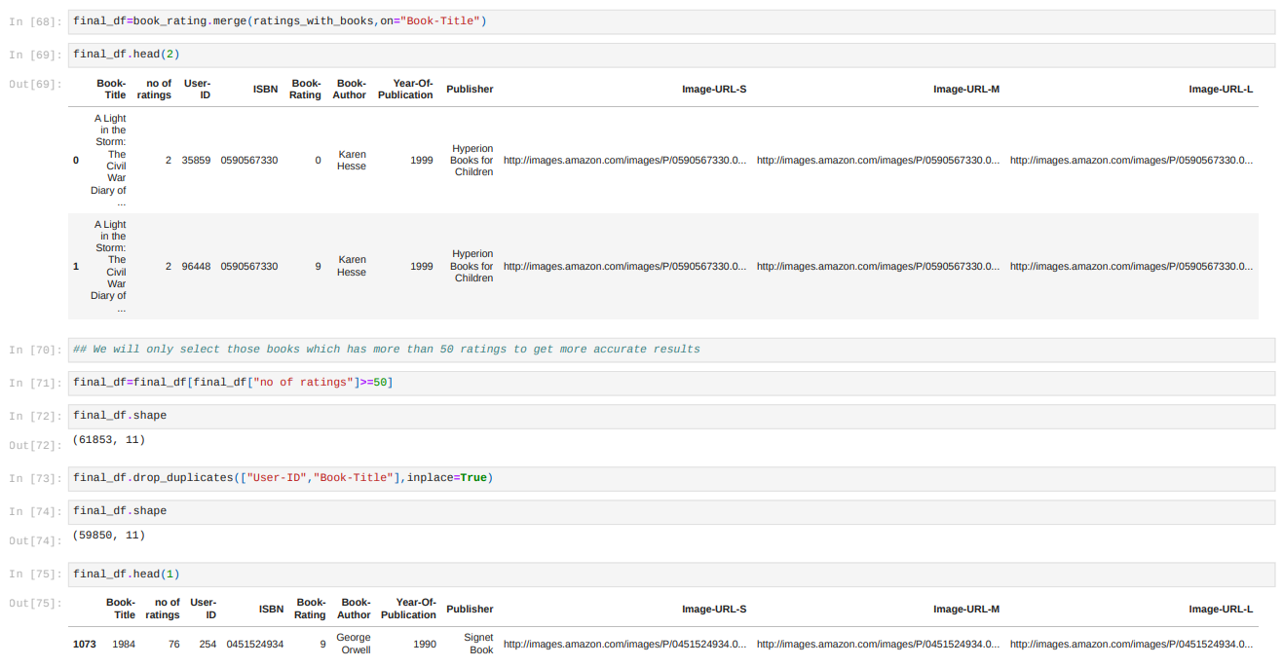

Slide 36
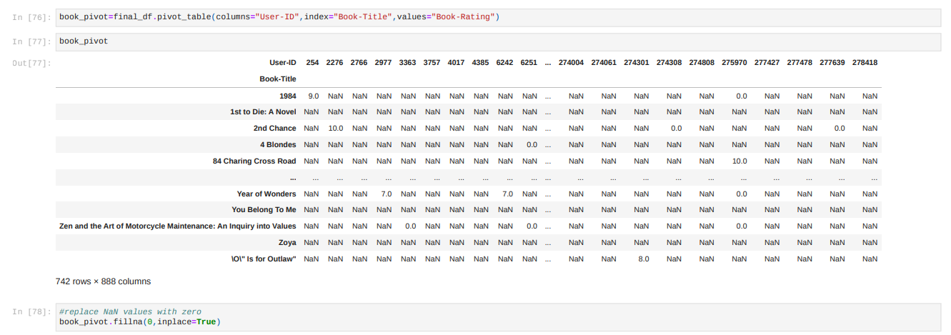
RATING MATRIX
We convert the ratings table to a 2D matrix.
The matrix will be sparse because not every user rated every book.

Slide 37
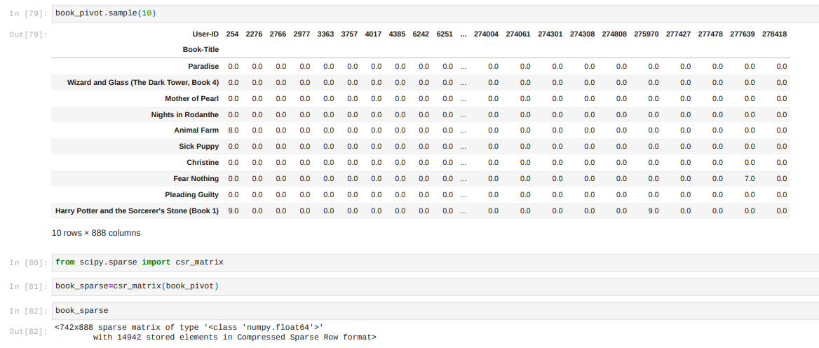

Slide 38
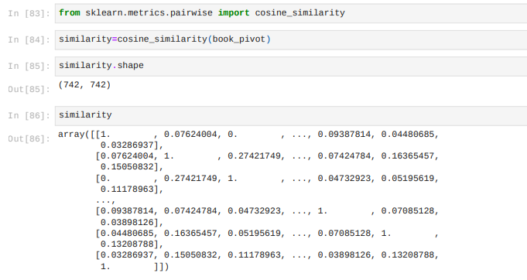
COSINE SIMILARITY
Cosine similarity is a metric used to measure the similarity of two vectors.
Specifically, it measures the similarity in the direction or orientation of the vectors ignoring differences in their magnitude or scale.
Both vectors need to be part of the same inner product space.
The similarity of two vectors is measured by the cosine of the angle between them.

Slide 39
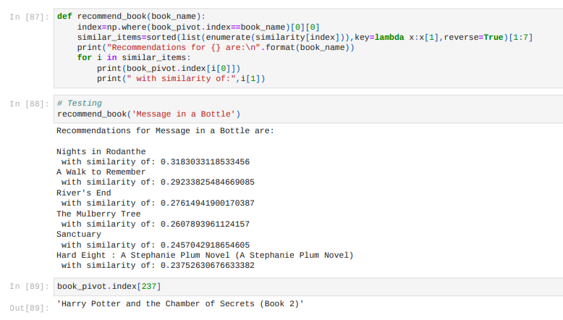
FUNCTION FOR RECOMMENDATION

Slide 40
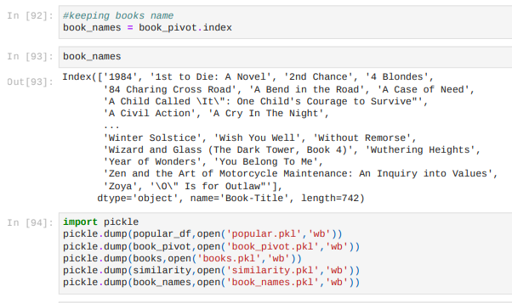
WE ARE USING THE “COLLABORATIVE FILTERING BASED RECOMMENDER SYSTEM” FOR MODEL DEPLOYMENT

Slide 41
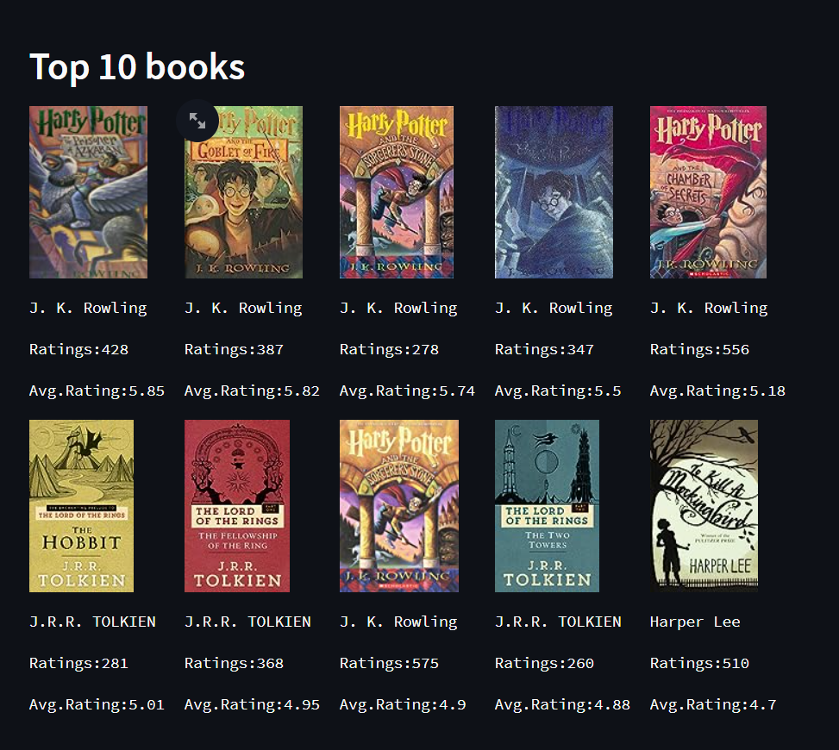
MODEL DEPLOYMENT

Slide 42



Slide 43

Thank You!

